Slide 1
Understanding York’s Retirement Process
Pension & Benefits, PEOPLE SERVICES, USC
2024

Slide 2
Welcome and Introductions
Pension & Benefits, People Services, University Services Centre (USC)
Shayne Dunkley
Lisa Crolla-nini
Pension and Benefits Specialist
Pension and Benefits Specialist
Host and Facilitator
Technical Co-Host

Slide 3
Land Acknowledgment
We recognize that many Indigenous Nations have longstanding relationships with the territories upon which York University campuses are located that precede the establishment of York University. York University acknowledges its presence on the traditional territory of many Indigenous Nations. The area known as Tkaronto has been care taken by the Anishinabek Nation, the Haudenosaunee Confederacy, and the Huron-Wendat. It is now home to many First Nation, Inuit and Métis communities. We acknowledge the current treaty holders, the Mississaugas of the Credit First Nation. This territory is subject of the Dish with One Spoon Wampum Belt Covenant, an agreement to peaceably share and care for the Great Lakes region.

Slide 4
Agenda
Understanding York’s Retirement Process
How your pension is calculated
What’s included in your retirement package
Pension options
Post retirement benefits
How to use the retirement planner

Slide 5
The Hybrid Nature of York’s Pension Plan

Slide 6
Understanding the Pension Plan
The York Pension Plan is a hybrid plan and made up of two parts:
1
2
Money Purchase Component
Minimum Guarantee Benefit
Provides you with a benefit based on the accumulated contributions and investment earnings of your account balance.
The amount of benefit earned depends on how well the investments in the fund perform and other factors (e.g., your age at retirement, your marital status and the age of your spouse if married).
Provides you with a benefit based on a formula that takes into account your earnings and service.
The amount of benefit you earn is guaranteed and does not depend on how well the investments in the fund perform.

Slide 7
What You Receive
At retirement, you will receive a pension based on the amount provided by your Money Purchase Component Account.
If your Minimum Guaranteed Benefit is greater than your Money Purchase Component Account pension, you will also receive a supplementary pension to bring your retirement income up to the amount of the Minimum Guaranteed Benefit.
You do not choose which benefit you receive, you simply get the higher of the two.

Slide 8
Minimum Guaranteed Benefit Formula (MGP)
1.4% of your final average earnings at retirement up to the average YMPE for those years
PLUS
1.9% of your final average earnings at retirement above the average YMPE for those years
MULTIPLIED BY
Your credited service
Final average earnings (commonly referred to as “FAE”) are based on your five years of highest earnings. The years do not have to be consecutive and a year is determined in 12 month blocks from the retirement date back.

Slide 9
Years Maximum Pensionable Earnings (YMPE)
The dollar amount set each year by the Canada Revenue Agency (CRA) which determines the maximum amount on which to base contributions to the Canada Pension Plan. The YMPE specifies the earnings amount that can be used in calculating pension contributions for each year.
For 2024 the dollar amount is $68,500.
The YMPE changes each year and CRA normally announces the new figure in November.

Slide 10
Pension Contributions
You contribute 6.75 % of your earnings up to the YMPE and 9.15% above. This split is calculated for each pay.
The contribution limit for 2024 as directed by the Canada Revenue Agency (CRA) is $32,490.
Your contributions are tax-deductible, and the tax savings happen at source when you are paid.
York University matches your contributions dollar for dollar
All contributions are tracked in your Money Purchase Account along with the rate of return.
The amount you accumulate is directly affected by the investment performance of the Trust Fund, and therefore will fluctuate.

Slide 11
Example 1
Member receiving a Supplementary Pension
Member retires with $250,000 in their Money Purchase Account
The annual pension provided by the Money Purchase Account is calculated to be $18,600
The minimum guaranteed benefit is calculated to be $22,200 annually
As the minimum guarantee benefit ($22,200) is greater than the money purchase pension ($18,600), this member receives a supplementary pension for the difference ($22,200-$18,600)
This member would receive an annual pension totaling $22,200 determined as follows:
Money Purchase Account Pension $18,600
Supplementary Pension (22,200 - 18,600) $ 3,600
Total Pension $22,200

Slide 12
Example 2
Member not receiving a Supplementary Pension
Member retires with $125,000 in their Money Purchase Account
The annual pension provided by the Money Purchase Account is calculated to be $11,000
The minimum guaranteed benefit is calculated to be $10,000 annually
As the minimum guarantee benefit ($10,000) is less than the money purchase pension ($11,000), this member does not receive a supplementary pension
This member would receive an annual pension totaling $11,000

Slide 13
Retirement Dates and Pension Maximums

Slide 14
Retirement Dates
Normal Retirement Date is the July first coincident with or immediately following your 65th birthday.
Earliest Unreduced Retirement Date is the first of the month coincident with or next following your 65th birthday.

Slide 15
Retirement Dates
Mandatory Receipt of Pension - Under the terms of the Income Tax Act, you must commence receiving your York University pension no later than the end of the year in which you reach age 71. Under the terms of the York University Pension Plan, this is the December 1st in the calendar year in which you reach age 71.

Slide 16
Maximum Pensions
The Income Tax Act limits the amount of pension benefit you may earn under the minimum guaranteed provision of the Plan
The Canada Revenue Agency maximum annual defined benefit limit (available at cra.gc.ca) multiplied by your credited service and
2% of the average of your three highest years’ earnings with the University, which may be subject to a reduction depending on your age, and continuous service
Notes:
These maximums generally only apply to high income earners around 170,000 and above.

Slide 17
Maximum Pensions
the pension provided by your Money Purchase Component Account pension may exceed the Income Tax Act limits.
if you have made any additional voluntary contributions, the amount of additional pension these contributions would purchase would not be included in this maximum.
if you purchased additional service as a result of transferring an amount from another registered pension plan, this amount would be included in the calculation of the Income Tax Act maximum.

Slide 18
What is included in your retirement Package?

Slide 19
Forms to be filled out and returned for a monthly pension option
Option selection form to be signed and witnessed.
Proof of age and your spouse's proof of age and social insurance number. Copies of birth, baptismal certificates, passports or Ontario Drivers licenses are acceptable.
If you are choosing a pension you will need to complete and return the following:
Request for electronic funds (CIBC Mellon)
Tax Withholding forms (TD1 and TD1ON)
Waiver of Joint & Survivor if choosing a pension option of less than a J&S 60%
Post Retirement Benefits Enrollment form (If applicable)

Slide 20
Forms to be filled out and returned for a transfer out of funds
Option selection form to be signed and witnessed.
Proof of age and your spouse's proof of age and social insurance number. Copies of birth, baptismal certificates, passports or Ontario Drivers licenses are acceptable.
If you are choosing a transfer out of funds you will need to complete and return the following:
Direct Transfer Request form (T2151)
Locking In Agreement
Request for Electronic Funds (CIBC Mellon for non locked in or cash portion if applicable)

Slide 21
When do I receive payment?
CIBC Mellon is our pension fund trustee and deposits your monthly pension on the 1st of the month unless the 1st falls on a weekend or holiday.
Pension payments are taxable, so income tax is deducted.
Deductions that you may have coming off your pay as an active employee are not deducted from pension payments such as Employment insurance, Canada Pension Plan and Union Dues

Slide 22
Will my pension increase or decrease?
Once you start receiving a pension that gross amount will never go down regardless of the fund rate of return.
Every January 1st the Moving Average Five-Year Fund Return is adjusted by a formula. The result is applied to your pension. When this calculated amount is greater than the pension you are receiving, we increase your pension. When the calculated amount is less than the pension you are receiving, your pension remains the same.
This calculated amount will be tracked to the next January 1st when the same calculation will be applied using the new Moving Average Five-Year Fund Return. When this calculated amount is greater than the pension you are receiving, we increase your pension. When the calculated amount is less than the pension you are receiving, your pension remains the same.

Slide 23
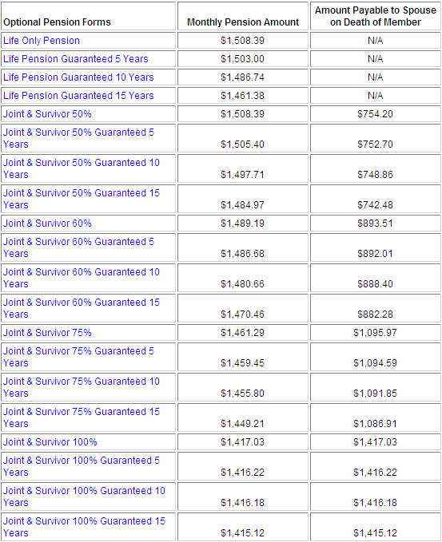
Pension Option Selection Form

Slide 24
Forms of pension in the York University Pension Plan
A life only pension is payable for your entire life and ceases when you pass away.
Joint & Survivor options are only available to members with a spouse.
The Joint & Survivor options are available at a percentage of 50, 60, 75 and 100%.
If you elect a J&S pension and pass away prior to your spouse, your spouse will begin receiving whatever percentage of pension you choose at the time of retirement.
If you have a spouse and choose any option less than J&S 60% your spouse needs to agree to this by signing a spousal waiver form. This is Ontario pension legislation.

Slide 25
Forms of pension in the York University Pension Plan
Guaranteed periods of 5, 10 and 15 years are offered in the York Plan.
If you have a spouse and choose a J&S 60% pension guaranteed for 10 years and you pass away 5 years after starting the pension, your spouse would receive 100% of the pension until the end of the 10 year guaranteed period at which point they would begin receiving 60% of the pension.
If both you and your spouse pass away prior to the 10 year guaranteed period expiring, a beneficiary(ies) of your choice receive a lump sum value of the remaining payments.
If you do not have a spouse and you pass away prior to the guaranteed period expiring the remaining payments are paid as a lump sum to a beneficiary(ies) of your choice.
It is important to remember that your pension is payable for your entire life.
The form of pension you choose at retirement is permanent and cannot be changed.

Slide 26
Post Retirement Benefits

Slide 27
Who can qualify for the Ontario Drug Benefit Program
You will qualify for the Ontario Drug Benefit (ODB) program when you turn 65 years old.
A letter will be sent to you about three months before your 65th birthday to let you know you will automatically join the Ontario Drug Benefit program on the first day of the month after you turn 65 years old.
For Ontario Residents Only – Prescriptions must be filled in Ontario
Prescriptions must be filled in an Ontario pharmacy
You must have your valid health card with you.

Slide 28
How do you know?
For seniors (people age 65 and older), a letter will be sent to you about three months before your 65th birthday to let you know you will automatically join the Ontario Drug Benefit program on the first day of the month after you turn 65 years old.
For Ontario Residents Only – Prescriptions must be filled in Ontario
Prescriptions must be filled in an Ontario pharmacy
You must have your valid health card with you.

Slide 29
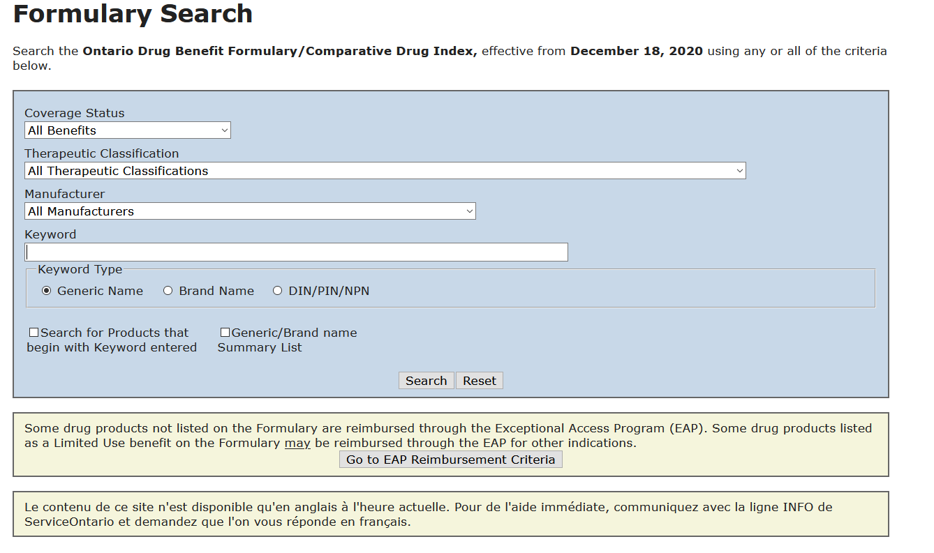
What is covered by the ODB
Allergy shots and epinephrine injectable products
Some products used to monitoring and testing for diabetes
Some prescribed over-the-counter drugs under specific circumstances
Some nutrition products
Formulary Search:
https://www.formulary.health.gov.on.ca/formulary/
You can look up a drug by name, brand or DIN
Brand Name vs. generic Drugs : ODB pays for what ever costs less

Slide 30
The ODB and SunLife
 | Single | Married
Income above $19,300 | $100 annual deductible, Maximum $6.11 co-pay
Income below $19,300 | No annual deductible Pay up to $2.00 co-pay
Combined income above $32,300 |  | $100 annual deductible, Maximum $6.11 co-pay
Combined income below $32,300 |  | No annual deductible Pay up to $2.00 co-pay
All costs can be claimed through Sun Life – either through your health care plan, or through your
health care spending account
Reimbursements will be subject to the terms of your Sun Life plan.

Slide 31
Post Retirement Benefits
Cost- No cost for 1356-1356-1 members.

Slide 32
Post Retirement Benefits: What is included?
The CUPE 1356 and 1356-1 Post Retirement Benefits Booklet can be found on our website at https://retire.info.yorku.ca/third-page/
CUPE 1356 Health care spending account $1,855
CUPE 1356 Health care spending account $1,650 per year

Slide 33
Retirement Planner
Access to the Planner is made available around May in the year following your enrollment into the pension plan.
The link to the planner can be found here: https://retire.info.yorku.ca/
To sign into the Planner for the first time click on forgot your password link and input your 9-digit employee number and click submit.
The password will be emailed to you. Go back into the Planner type your employee number in the applicable box and then type your password in the applicable box.
You can not copy and paste the password. You must type it and it is case sensitive.

Slide 34
Retirement Planner
Link:
https://yorku-ret.ca/

Slide 35
Link:
https://yorku-ret.ca/

Slide 36
Q & A

Slide 37
Contact Pension & Benefits
E-mail askpb@yorku.ca
Call 416-736-5853 – the phone line is open from 9:00 am to 4:00 pm Monday to Friday. For Fridays in June, July and August the phone line closes at 3:00 pm.
Please have your employee ID ready when you call us.
Any form or document that we may need from you can be completed, scanned and emailed to askpb@yorku.ca.

Slide 38
Thank you for your engagement!

